Slide 1

presentation of system modelling
DRESSING UP
Group 12

Slide 2
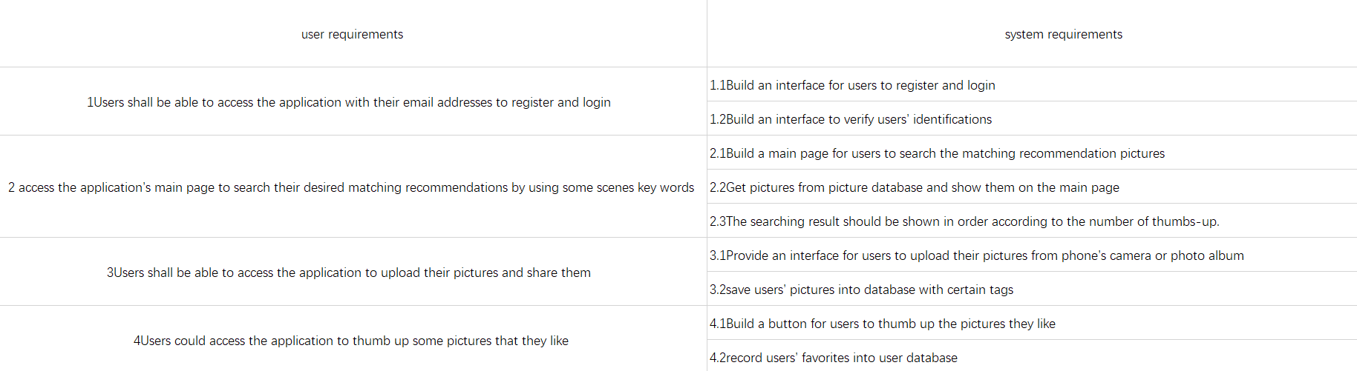
requirements

Slide 3
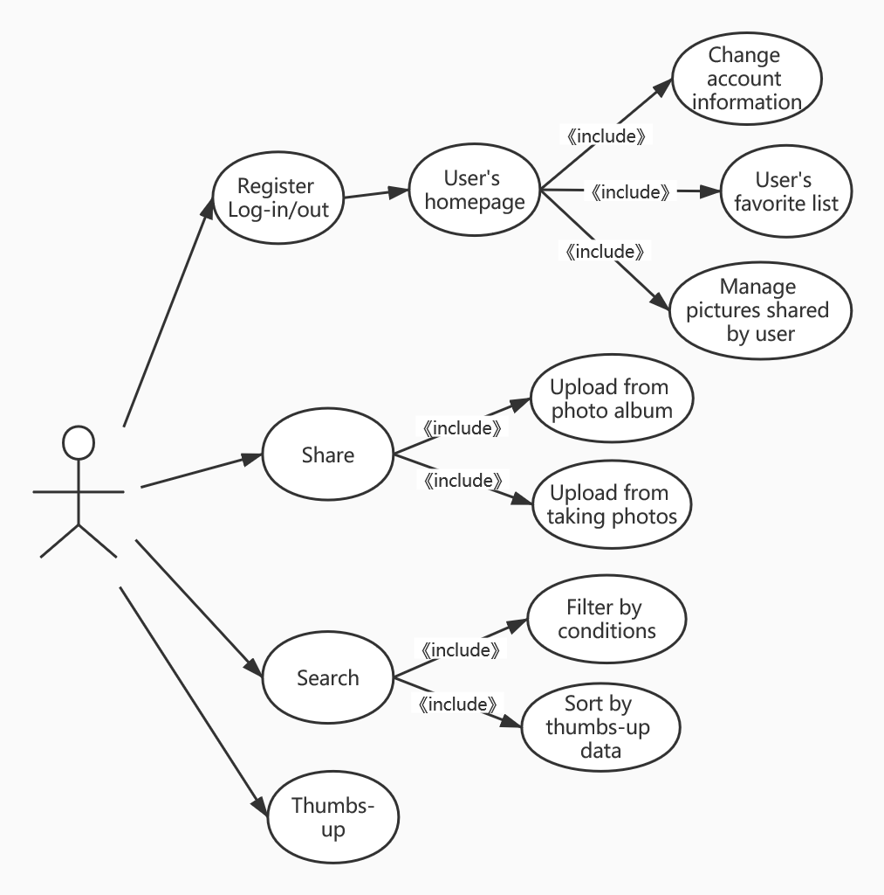
use case diagram for user requirements

Slide 4
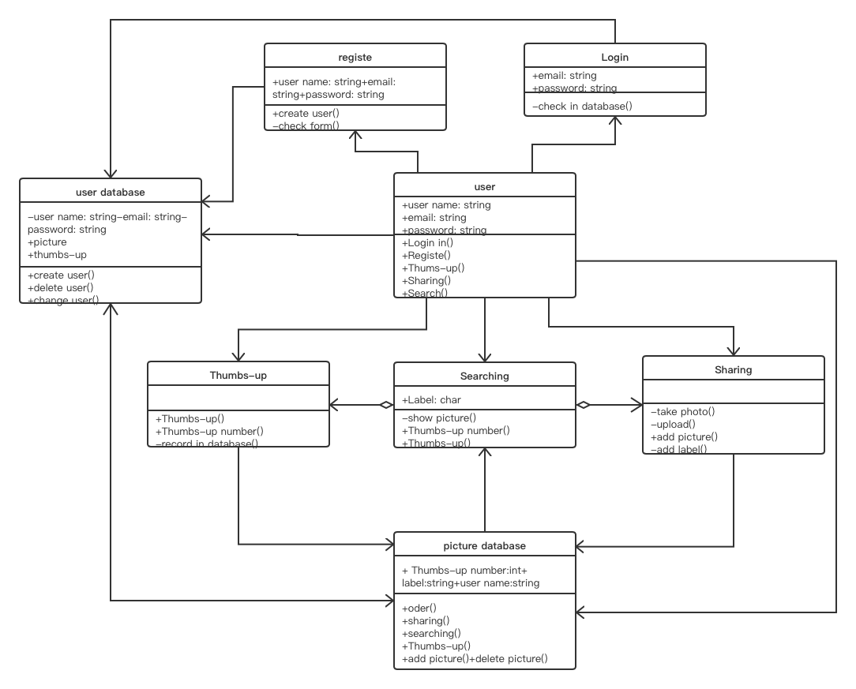
THE CLASS DIAGRAM OF OVERALL SYSTEM

